Slide 1
2021 PhD Application
Jun Li
Supervisor: Jin Chang
2021/05/08

Slide 2
Self Introduction
Graduated from Software Engineering, Department of Computer Science , Shandong University.
Research direction is lhaaso and indirect dark matter detection，co-supervised by Xiaoyuan Huang in PMO.
Course grade and participation in academic activities during the master's degree：
The weighted average score of professional courses is 78, and the English level 6 is 425 points.
Participate in "LHAASO collaboration & Construction Meeting" in April 2021.
The shielding effect of cosmic rays about planets on cosmic rays.

Slide 3
Grade
课程编号 | 课程名称 | 成绩 | 学分 | 学时 | 教 师
FL05301 | 研究生综合英语 | 通过 | 2 | 40 | -
PS05101a | 自然辩证法概论 | 通过 | 1 | 18 | 李文忠
PS05102a | 中国特色社会主义理论与实践研究 | 通过 | 2 | 36 | 张勤
FL05302 | 日常交流英语 | 通过 | 2 | 40 | -
FL06301 | 科技论文写作 | 通过 | 2 | 40 | 夏学文
AY15207 | 天体物理中的辐射过程 | 77 | 4 | 80 | 林宣滨
ES15210 | 可编程逻辑器件原理及应用 | 70 | 3 | 60 | 宋克柱
ES15702 | 物理电子学逻辑设计与仿真实验 | 85 | 2 | - | 宋克柱
PH24212 | 核与粒子物理导论 | 65 | 4 | 80 | 黄光顺
SH05105 | 西方科技史 | 82 | 4 | 80 | 石云里
AY15218 | 天文数据处理 | 93 | 3 | 60 | 刘桂琳
AY15221 | 粒子宇宙学 | 98 | 3 | 60 | 蔡一夫
AY16206 | 宇宙大尺度结构 | 75 | 4 | 80 | 王慧元
004017 | 粒子探测技术 | 60 | 4 | 80 | 刘建北
LB05203a | 文献管理与信息分析 | 93 | 3 | 60 | 罗昭锋
GPA：2.82

Slide 4
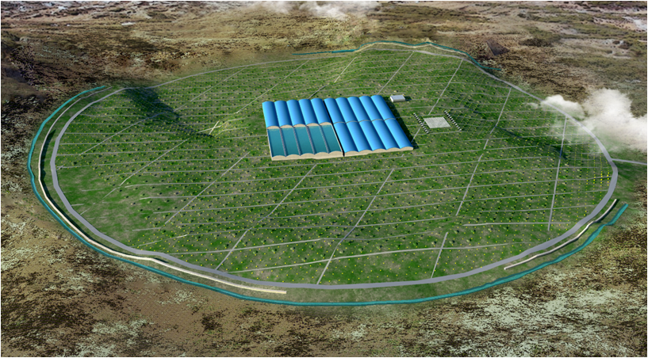
LHAASO
LHAASO and sheild effect of the celestial bodies
Analysis of some point sources
LHAASO and indirect detection of dark matter (PhD)

Slide 5
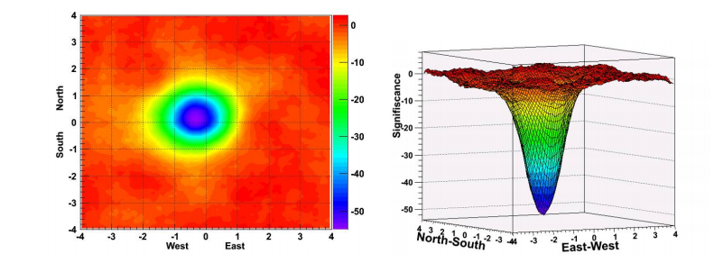
Moon shadow
By conducting a detailed study on the moon shadow, we can check the orientation system error of the detector, estimate the angular resolution of the detector and calibrate the energy of the detector.

Slide 6
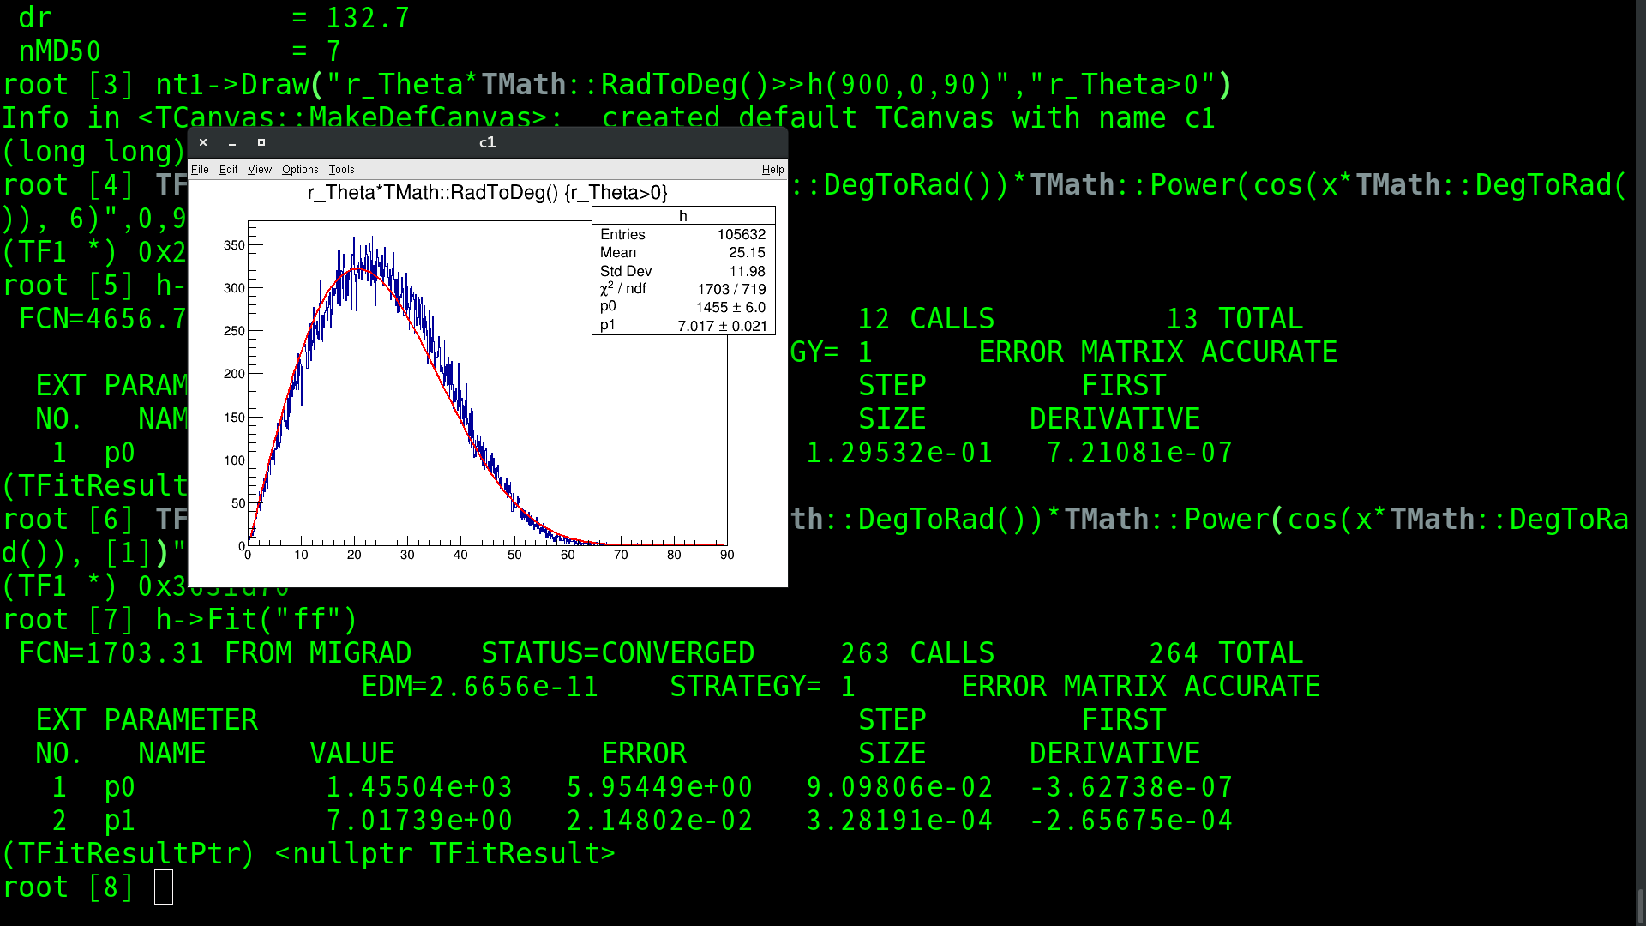

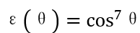
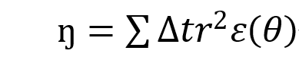
Sheild effect of the celestial bodies
Time interval
Zenith angle
A measure of cosmic ray occlusion effect
Detection efficiency
Apparent radius
The purpose of the research is to imitate the analysis and calculation of the planets shadow effect, comparing the moon.
(Cut: zenith < 40°，2020/1/1 00：00——2024/12/30 00：00)

Slide 7
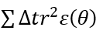
Sheild effect of the celestial bodies
Ratio to ŋ of the moon
Celestial bodies | ŋ | Rate
Critical-list numbered minor planets(650) | 6.98885e-07 | 3.374298879685758e-09
Distant minor planets(3747) | 3.55714e-05 | 1.7174289785709234e-07
Unusual minor planets(18169) | 0.0857058 | 0.0004137976704644851
All minor planets(22166) | 0.085742070285 | 0.00041397278766122186
The minor planets
Mars | 0.00689729430695 | 3.330094715554683e-05
Venus | 0.0381211310996 | 0.00018405329912894708
Mercury | 0.00318853988725 | 1.5394645141018947e-05
Jupiter | 0.0803391225414 | 0.0003878867212579793
Saturn | 0.000861242620965 | 4.1581805462412636e-06
Uranus | 0.00145070563109 | 7.0041772047487175e-06
Neptune | 0.000153157267836 | 7.394612808612953e-07
The major planets
Comets | 2.55247e-07 | 1.2323625004731116e-09
Comets

Slide 8
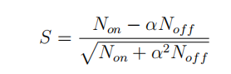
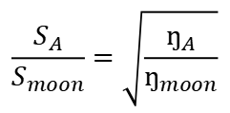
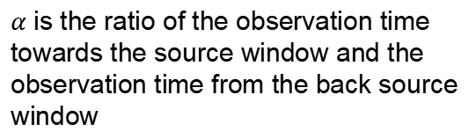
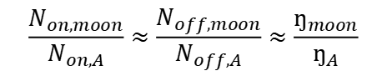
Significance
For a certain celestial body A：
$α$ is the ratio of the observation time towards the source window and the observation time from the back source window
formula for calculating significance
$$\frac{N_{on,moon}}{N_{on,A}}≈\frac{N_{off,moon}}{N_{off,A}}≈\frac{ŋ_{moon}}{ŋ_{A}}$$
$$\frac{S_{A}}{S_{moon}}=\sqrt{\frac{ŋ_{A}}{ŋ_{moon}}}$$
Without involving coincidence and magnetic field, we can get：
form Rui Zhang’s report
$$S_{Venus }=0.01357∗S_{moon}=0.01357∗103.25=1.401$$
$$S_{Jupiter }=0.01969∗S_{moon}=0.01969∗103.25=2.032$$

Slide 9
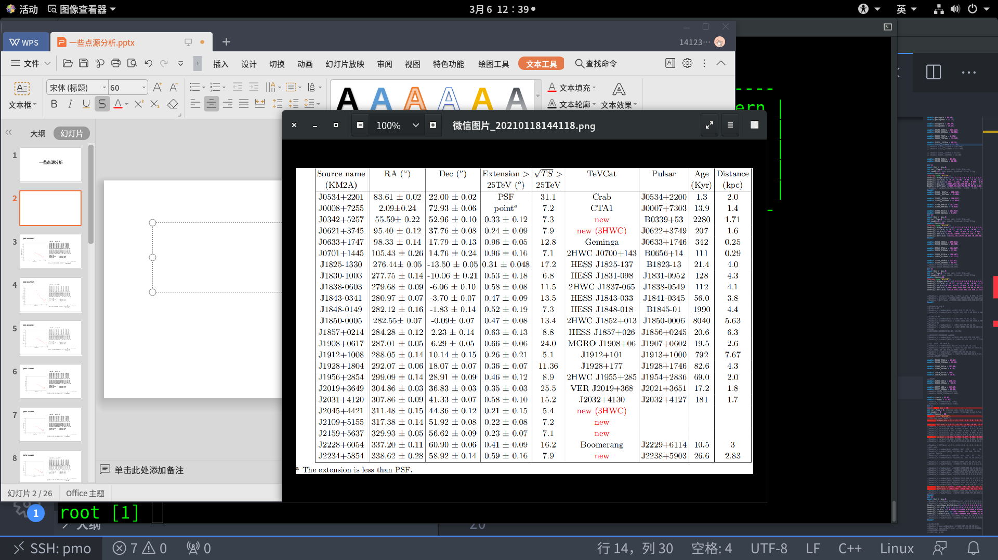
Analysis of some point sources
In order to check the correctness of 3D energy spectrum analysis.
In order to be familiar with the LHAASO energy spectrum analysis process and get the DM limits of LHAASO

Slide 10
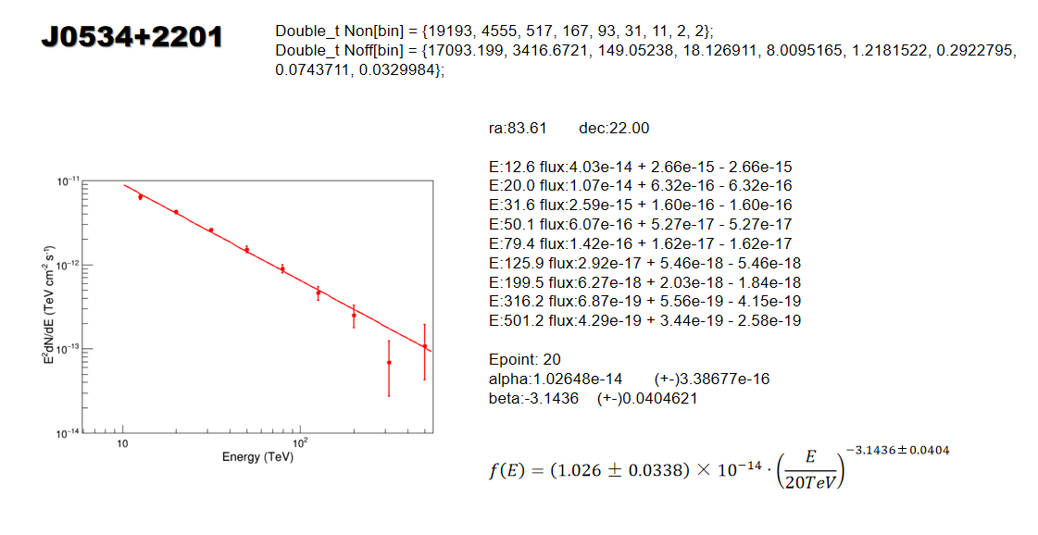
Example of point source analysis

Slide 11
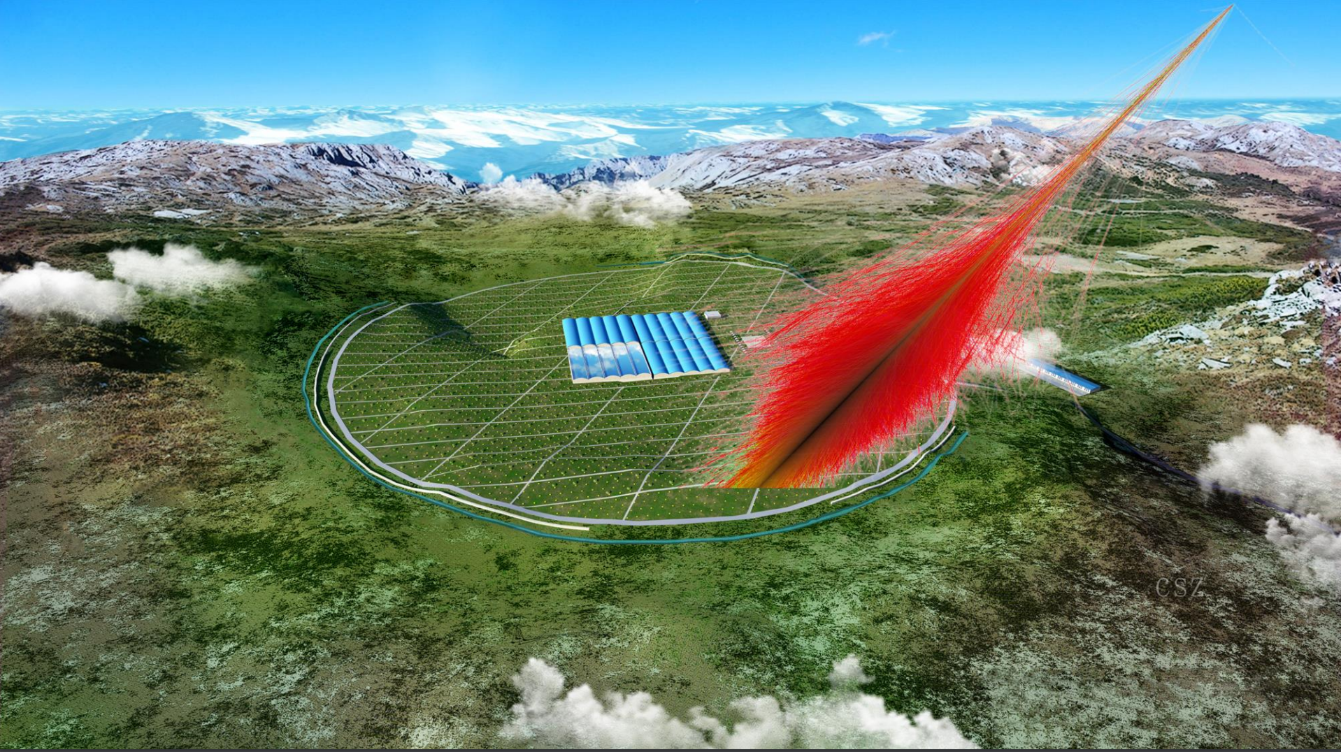
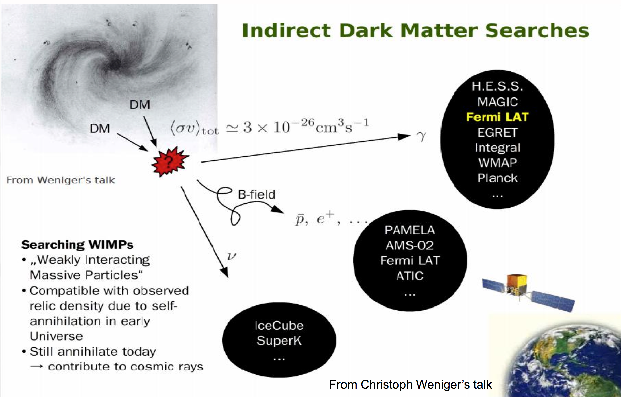
LHAASO and indirect detection of dark matter
Research the indirect detection of dark matter through lhaaso

Slide 12
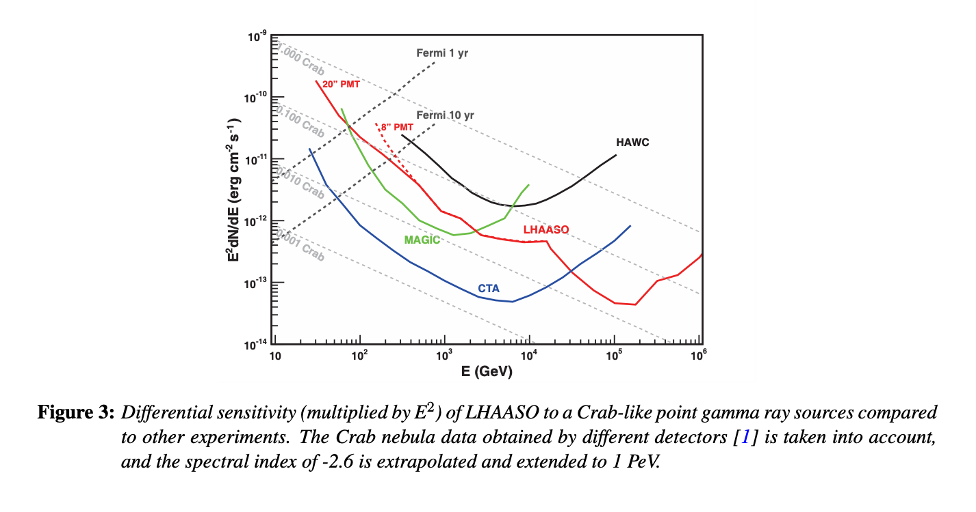
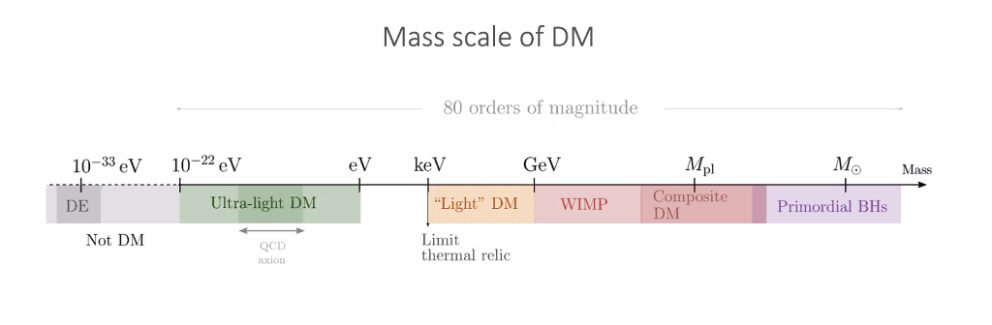
LHAASO and indirect detection of dark matter

Slide 13
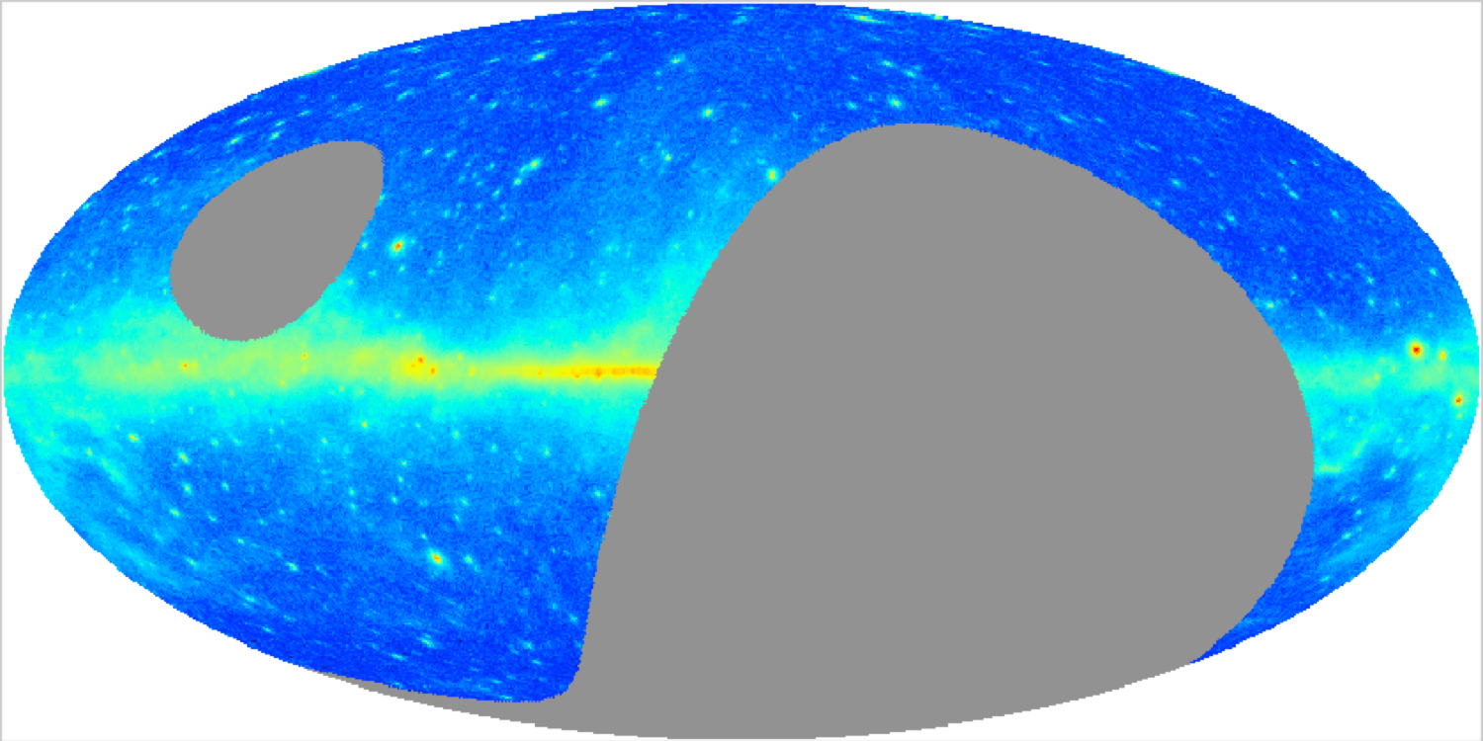
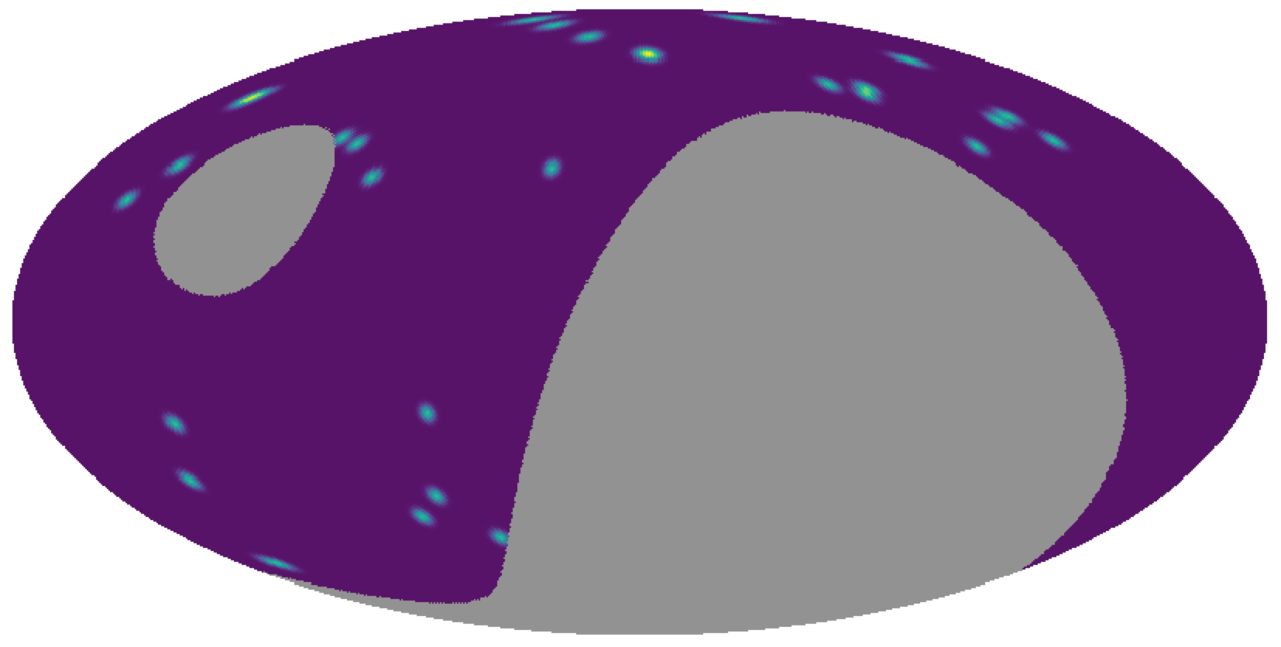
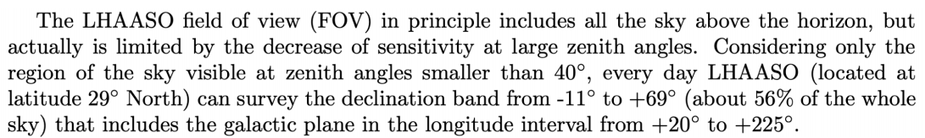
LHAASO FOV
The mass-to-light ratios in dSphs can be of very large order of magnitude, which suggests that they are significantly DM dominated systems.

Slide 14
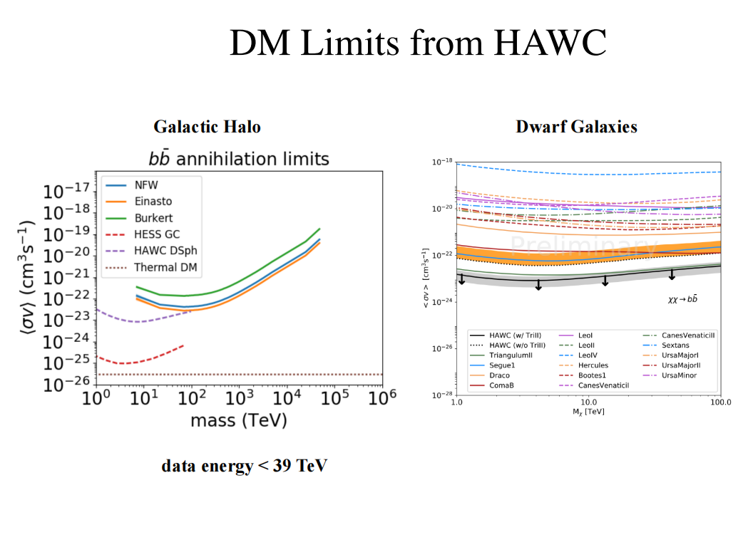
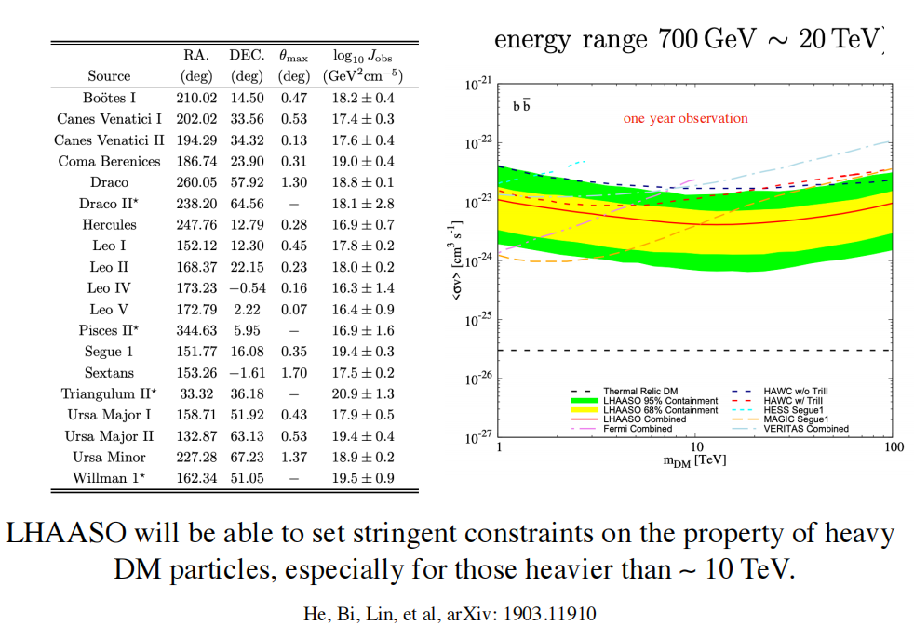
Research direction during PhD
LHAASO and dwarf galaxies

Slide 15
Research direction during PhD
Dwarf galaxies
Signals
Annihilation
Galaxy clusters
Decay
Limits
DM halos

Slide 16
Thank You

